Slide 1
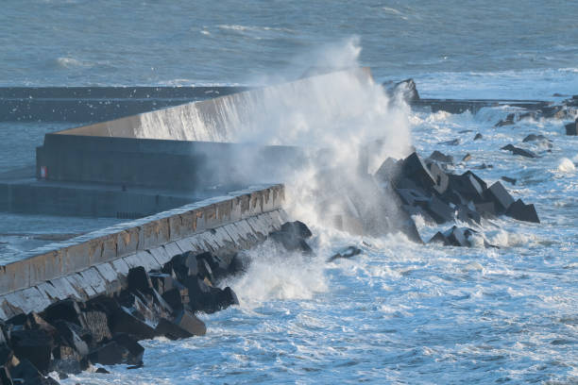
Time Series Wave Height Prediction
By: Alex Khater,
Kentaro Osawa,
Abhimanyu Barun

Slide 2
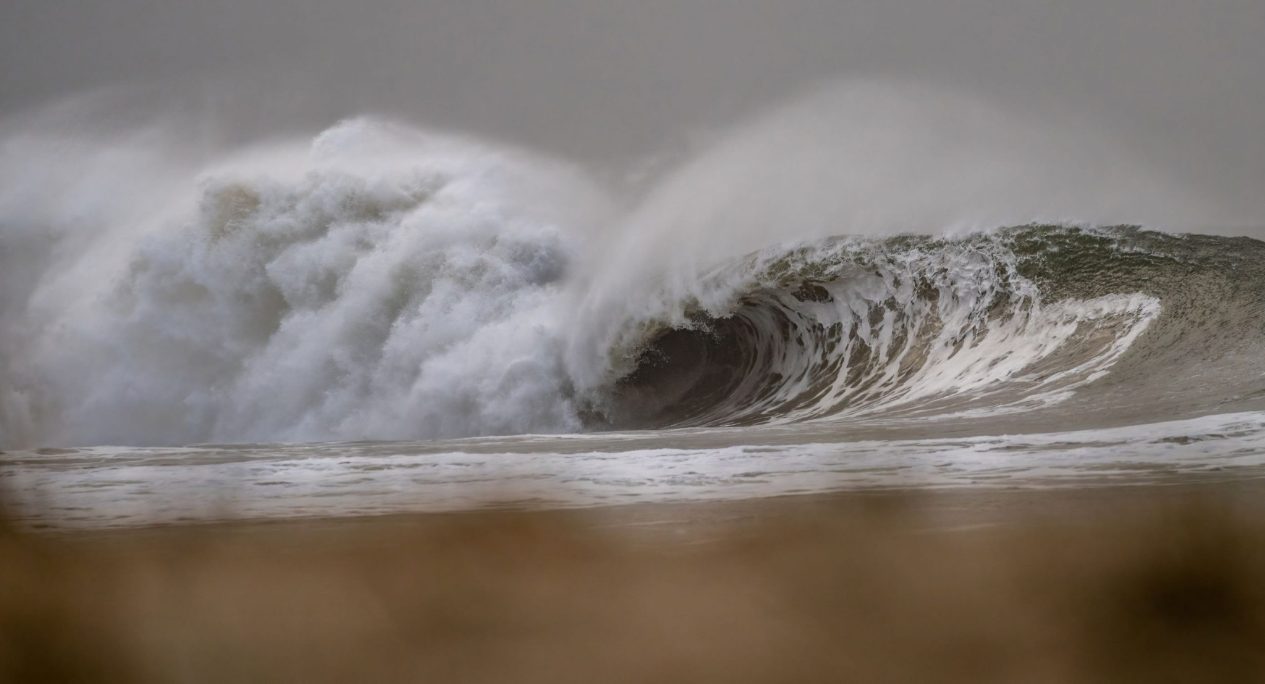
Why is this relevant ?
As Climate Change worsens, the ocean’s conditions will also alter
Even a small increase in Wave height can cause massive and dangerous consequences to -
Coastal Cities
Boats
Anti-Flood Infrastructure
Agriculture
Being Able to Predict Future Wave Height Can Allow Governments to Prepare
Image Source: https://www.sunshinecoastnews.com.au/2022/07/25/sunshine-coast-record-wave-heights/

Slide 3
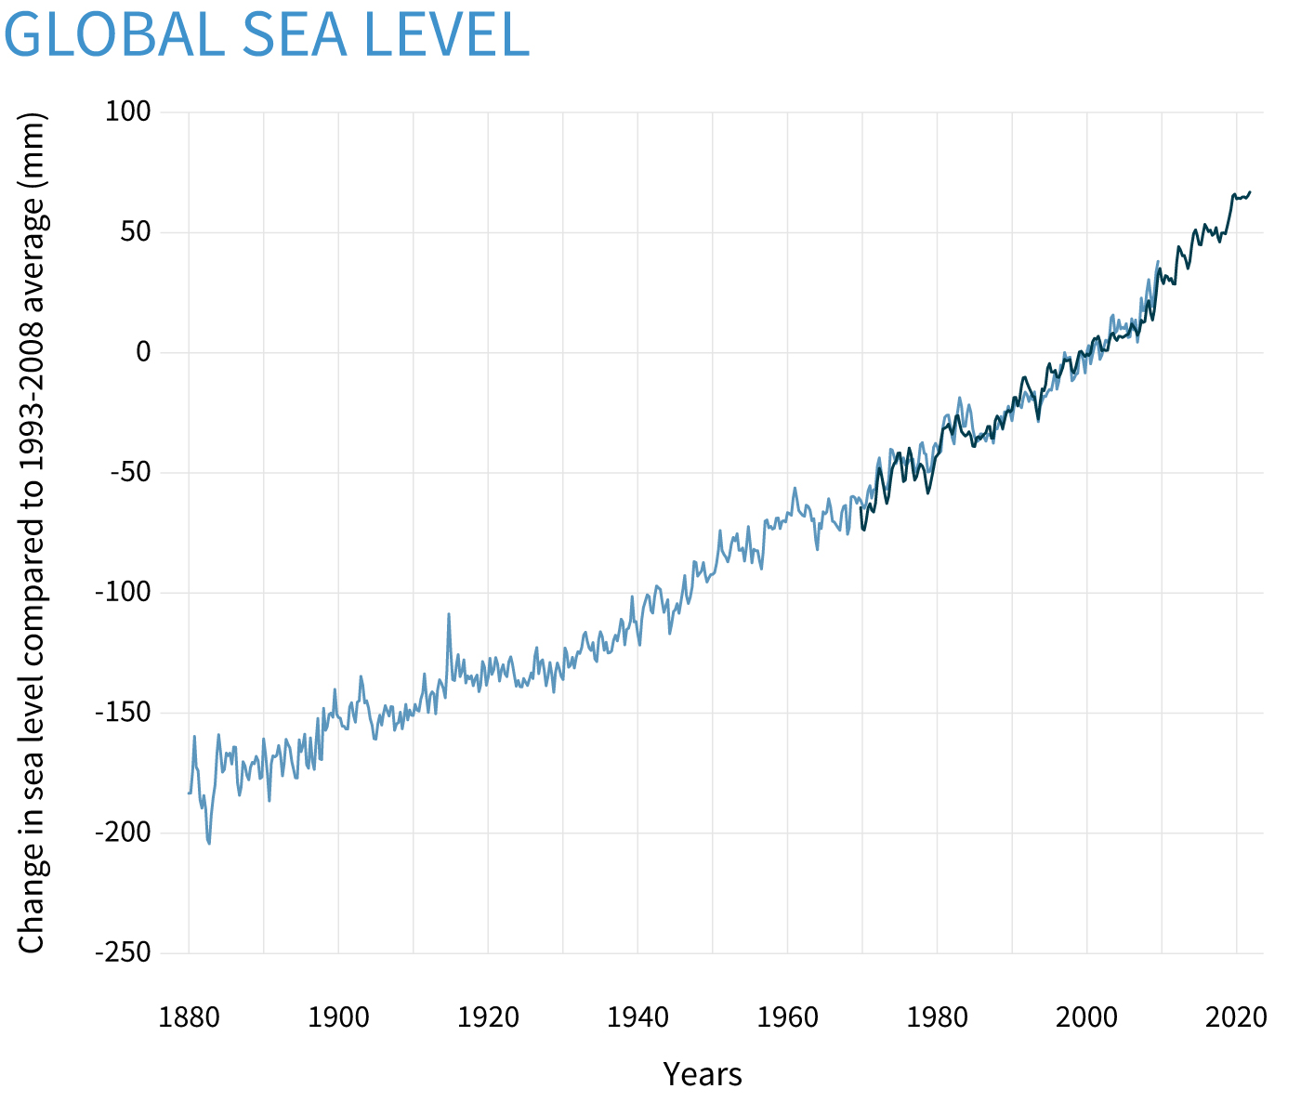
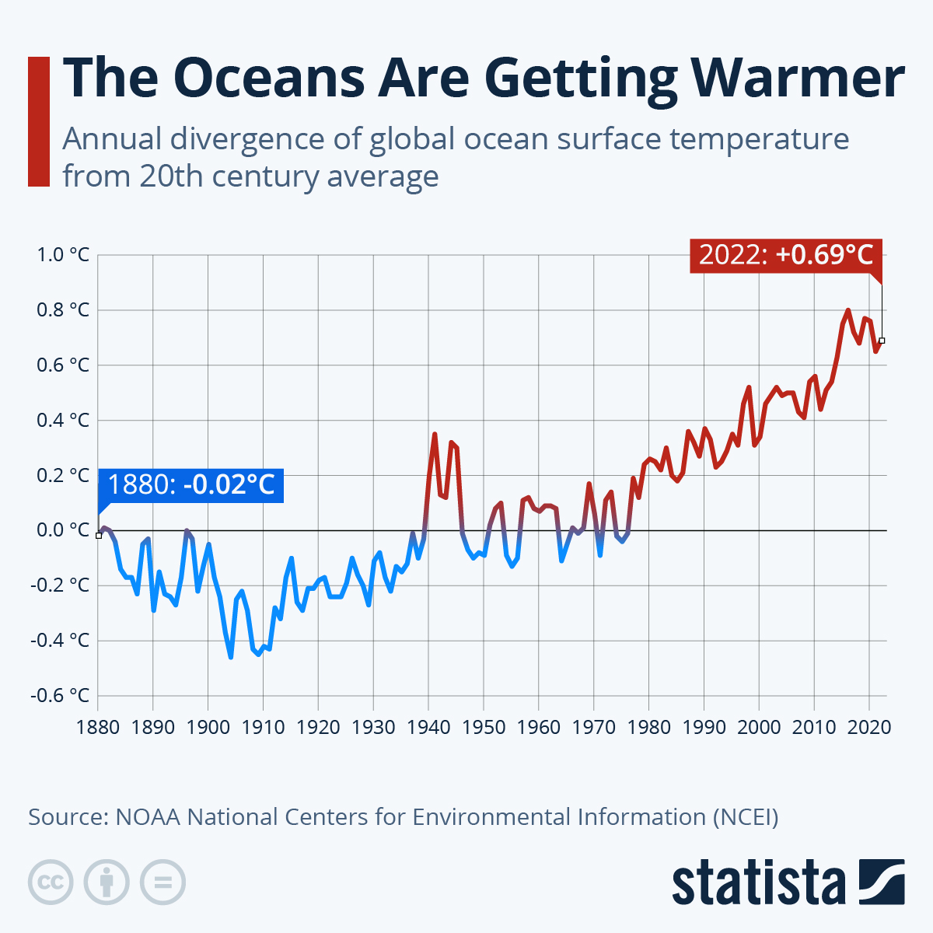
The Urgency of The Project
Image Source:
Left: https://www.climate.gov/news-features/understanding-climate/climate-change-global-sea-leve
Right: https://www.statista.com/chart/19418/divergence-of-ocean-temperatures-from-20th-century-average/
Notes:
https://drive.google.com/file/d/1lA8BwAbbXJQck4sPfvph71nYIBjmzQvf/view?usp=sharing

Slide 4

Data Source
Big Idea
Waves Measuring Buoys Data
Measured and derived wave data from data collected by oceanographic wave measuring buoys anchored at Mooloolaba.
Source
This data comes from Queensland Government -
https://data.qld.gov.au/dataset.
Geological Survey of Queensland’s (GSQ) provides geoscience and resource information to improve the understanding of the geology and minerals and energy resource potential of Queensland.

Slide 5
The Dataset
3 years of data bi-hourly from the Mooloolaba beach
43,000+ Observations
The data includes features such as:
Max Wave Height
Average of the Top 3rd Wave Height
Sea Temperature
Zero Period
Peak Energy
Direction
Date and Time Observations

Slide 6
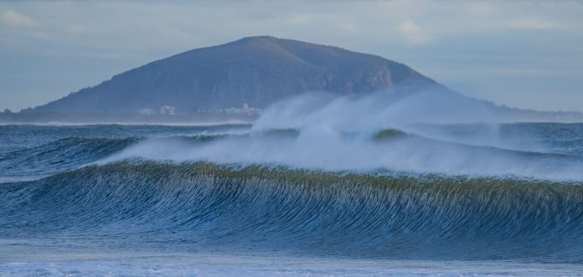
Scope Of Project
Goals of Project
Use Time Series Analysis Techniques and EDA to create informative Visualizations
Create a precise regression model to Forecast Average Top 3rd Wave Height as Sea Temperatures continue on their trend
Image Source:https://www.sunshinecoastnews.com.au/2022/07/25/sunshine-coast-record-wave-heights/
Notes:
https://drive.google.com/file/d/1lA8BwAbbXJQck4sPfvph71nYIBjmzQvf/view?usp=sharing

Slide 7
Cleaning Process
Used the Drift Method to fill missing days
Had to cut the data at 2019-01-06 because of uneven sampling
No categorical Variables to encode
Final dataset length: 35281

Slide 8
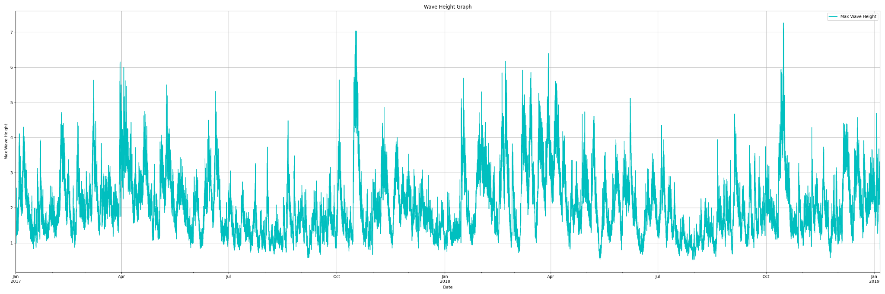
Plotting the Target Variable

Slide 9
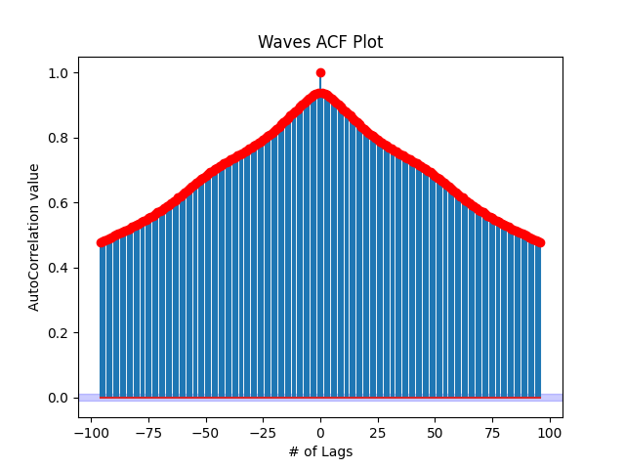
ACF Plot
Notice the little bump in the ACF values at about lag= +/- 48 ?
→ Daily seasonality

Slide 10
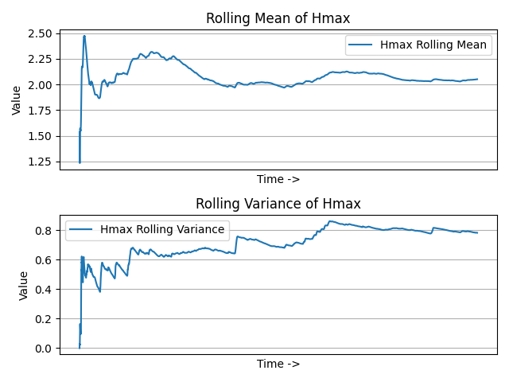
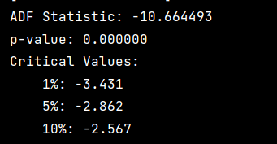
Stationary ?

Slide 11
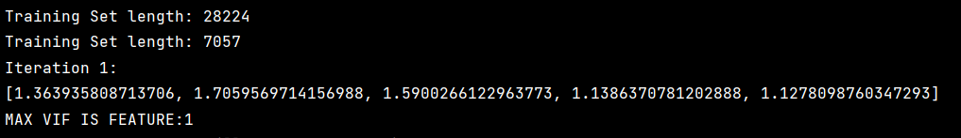
BASIC REGRESSION: VIF
All VIF values are below 2, so no dimensionality reduction is required

Slide 12
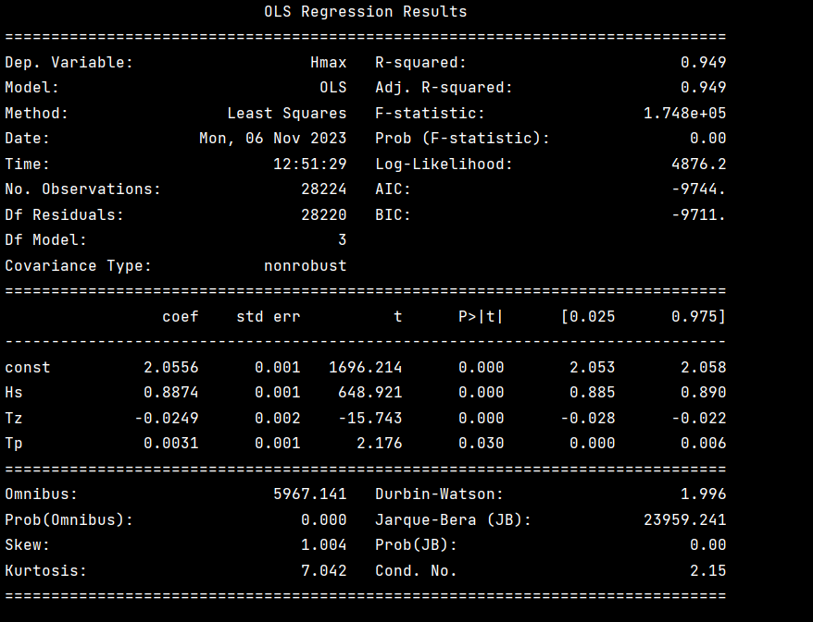
BASIC REGRESSION: Backwards Stepwise Regression
After 4 rounds:
The Final Model keeps 3 variables: Hs, Tp, and Tz

Slide 13
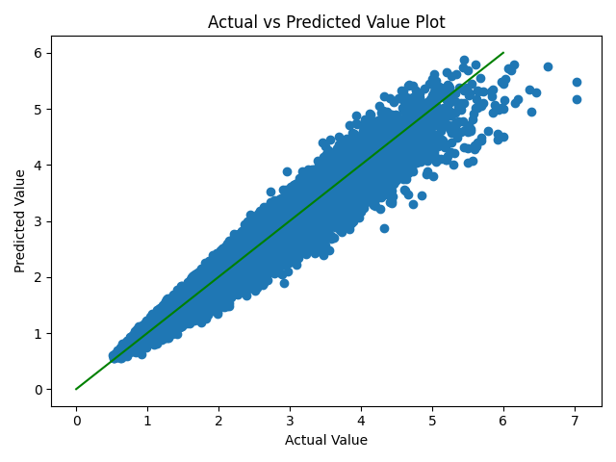
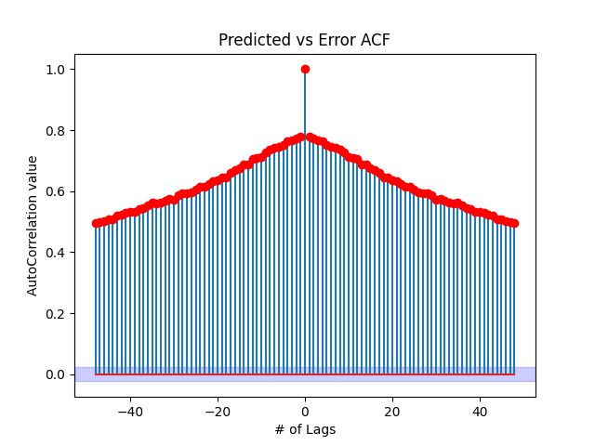
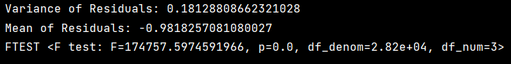
BASIC REGRESSION: Residual Analysis

Slide 14
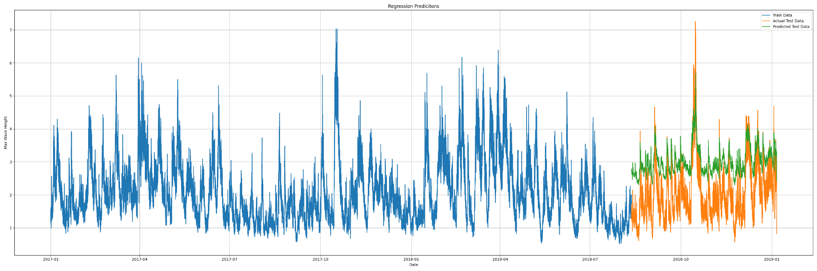
BASIC REGRESSION: Plotting Predictions

Slide 15













Logical Architecture and Data Flow
AWS Cloud
Region
VPC
HTTP
Store the data in S3 bucket
Load the data to EC2 instance and explore the data (EDA)
Store the EDA results in S3 bucket
Develop models and make predictions using EC2
Store the prediction results in S3 bucket
Host a static website on S3 bucket

Slide 16

Logical Architecture and Data Flow
AWS Cloud
Region
VPC
HTTP
Store the data in S3 bucket
Load the data to EC2 instance and explore the data (EDA)
Store the EDA results in S3 bucket
Develop models and make predictions on Google Calab
Store the prediction results in S3 bucket
Host a static website on S3 bucket

Slide 17
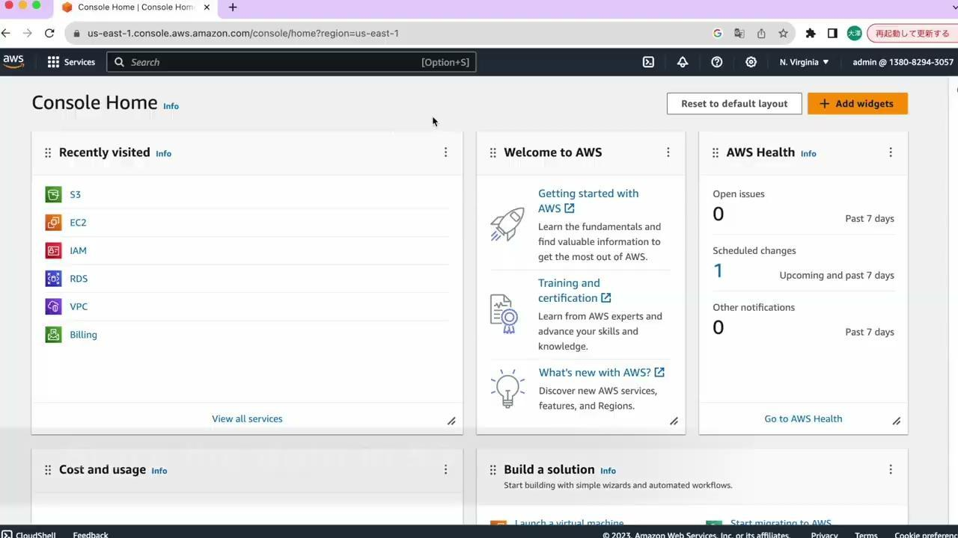
Project Implementation
Demo
Static Website
http://final-project-group13-2.s3-website-us-east-1.amazonaws.com

Slide 18
Thank You!

